Slide 1
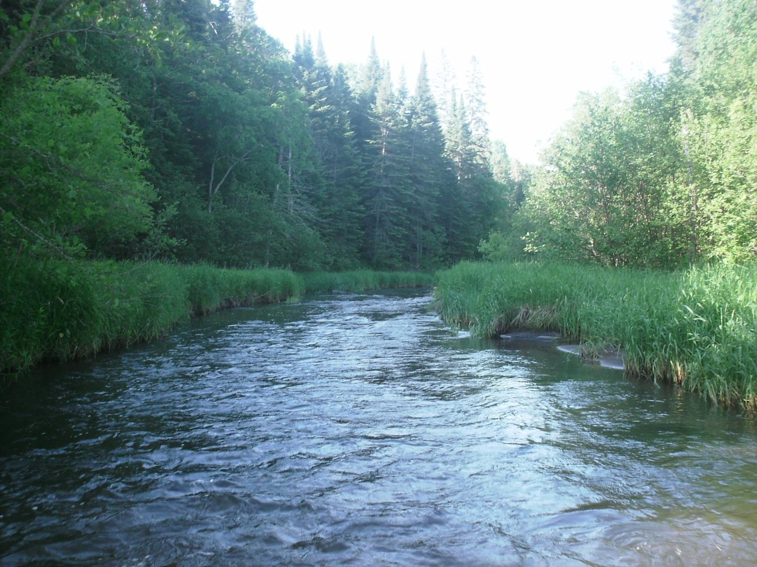
Legislative Water Commission
December 10, 2018
Co-chairs: Senator Wiger Representative Torkelson*
* Presiding
Jim Stark, Director
1

Slide 2
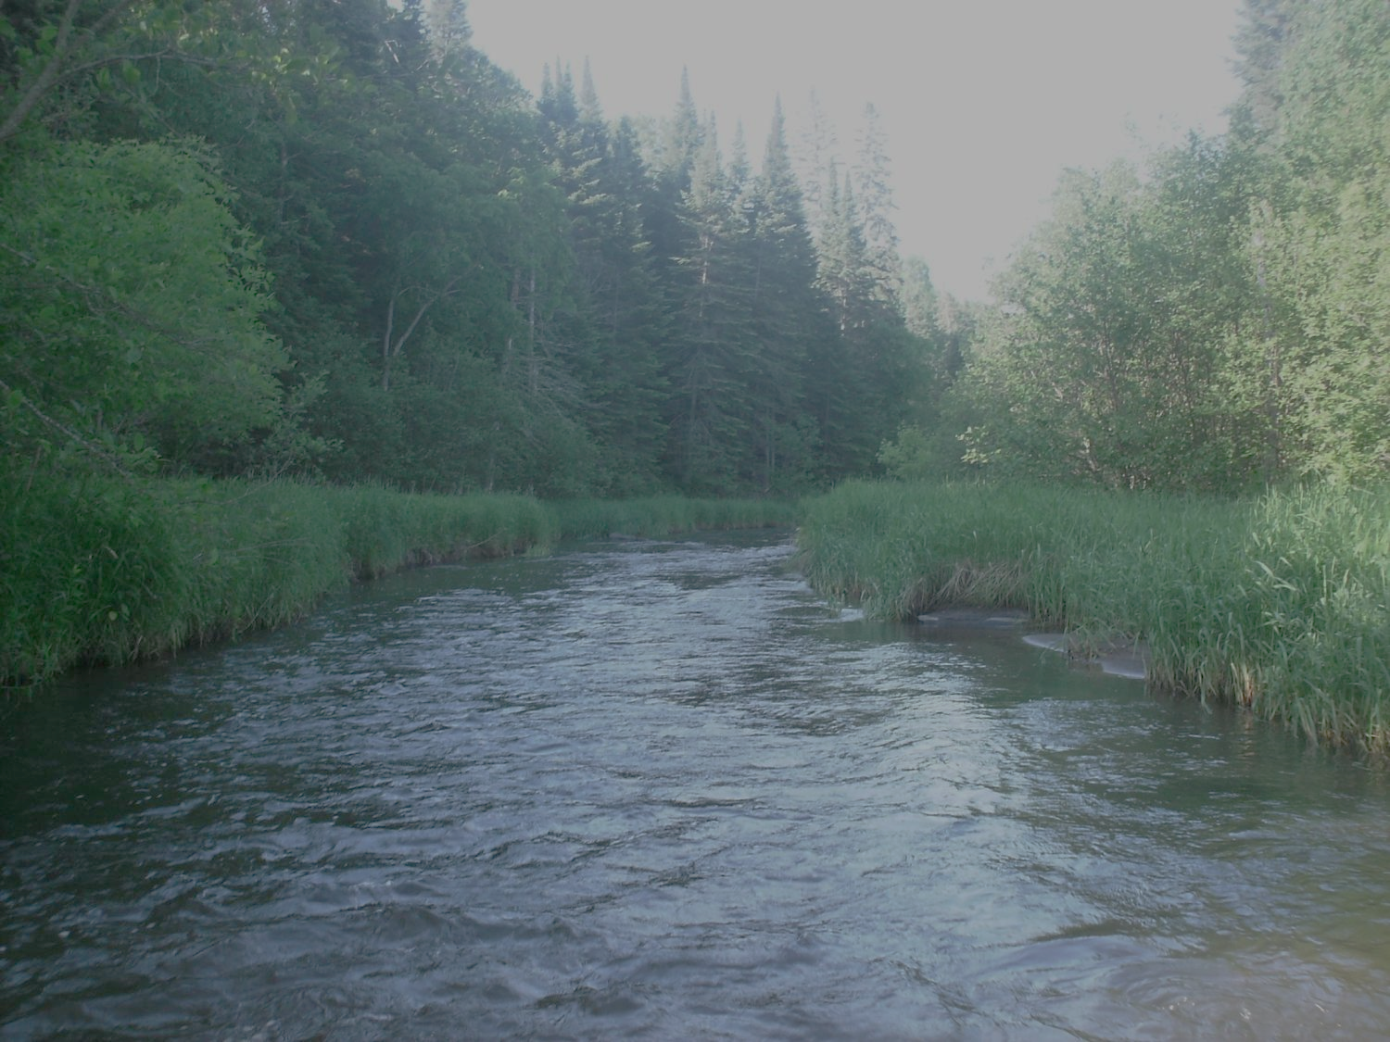
Legislative Water Commission
Monday , December 10, 2018 (10 am)
State Office Building: Room 10
* Rep. Paul Torkelson, Chair
Sen. Chuck Wiger, Co-Chair
* Presiding
Agenda
Approval of minutes- November
ASCE Water Infrastructure Report Card: Nathan Zacharias, Dennis Martinson, Jason Staebell (15m)
Discussion and consensus—2019 LWC Legislative Recommendations
Discussion, next steps
Discussion: Meeting schedule during session
Adjourn
2

Slide 3
Outstanding Service Award
Legislative Water Commission
IS HEREBY PRESENTED TO:
Representative Clark Johnson
Representive David Bly
IN RECOGNITION OF DEDICATED SERVICE AND LASTING
CONTRIBUTION TO THE LEGISLATIVE WATER COMMISSION
Representive Paul Torkelson- Chair
Senator Charles Wiger- Co-Chair
“Restoration, protection and enhancement of the Waters of the State of Minnesota.”

Slide 4
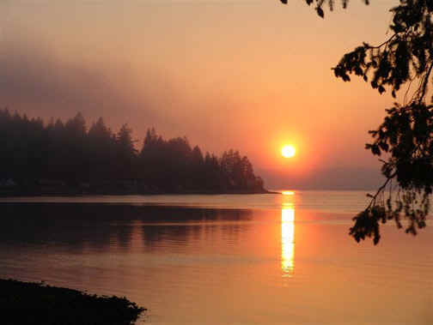
13 Recommendations
(not in priority order)
Expanded source water protection
Reducing excess chloride
Water Sustainability: Data, Information, Education
Increase drinking water protection fee
Keeping Water on the Land
Inflow and Infiltration
Continuation of the LWC
Healthy Soil/ Healthy Water
K-12 Water Education
Preserving and protecting our lakes
Peer review of wastewater standards
Water Infrastructure
Statewide Water Policy
Notes:
For more information and real time monitoring data you can visit this web site.

Slide 5
Recommendations:
Based on discussions: LWC Member comments
Stakeholders suggests
Agency suggestions and comment
Recommendations for Legislation
Legislative funding recommendations
Support for proposed stakeholder bills
Funding recommendations for agencies
Support for agency programs
5

Slide 6
1) Expanded Source-Water Protection
2019 Legislative Recommendations
Legislative Water Commission
Water Sustainability: Information, Education and Public Awareness
November, 2018
LWC_2019_Recs_November_with_Leg_Bill_Sustainablity_Info_Education_Awareness.docx
2019 Legislative Recommendations
Legislative Water Commission
Water Sustainability: Information, Education and Public Awareness
November, 2018
LWC_2019_Recs_November_with_Leg_Bill_Sustainablity_Info_Education_Awareness.docx
Issue: Enhanced source-water protection for drinking water
Action: Legislative Funding and Recommendations
Budget Impact: Minor impact (see below)
Justification:
Expand protection to all drinking water sources
Expand to rivers and private wells
Identify and protect most-vulnerable aquifers
Support CWC’s policy and approaches
Specific recommendations:
Map most-vulnerable aquifers, use existing info, GRAPS process ($300,000).
Policy, authority to protect vulnerable aquifers ($300,000)
Pilot real-time river monitoring to detect threats ($200,000)
Improve outreach regarding contaminants in drinking water ($200,000)
Support CWC’s policy on vegetative cover
Agencies: (MGS, MDNR. MDA, MPCA MDH)
Discussion and decision

Slide 7
2) Reducing excess chloride in our waters
2019 Legislative Recommendations
Legislative Water Commission
Water Sustainability: Information, Education and Public Awareness
November, 2018
LWC_2019_Recs_November_with_Leg_Bill_Sustainablity_Info_Education_Awareness.docx
2019 Legislative Recommendations
Legislative Water Commission
Water Sustainability: Information, Education and Public Awareness
November, 2018
LWC_2019_Recs_November_with_Leg_Bill_Sustainablity_Info_Education_Awareness.docx
Issue: We over apply chloride-based de-icers
Action: Legislative Funding and Legislation
Budget Impact: Minor impact (see below)
Justification:
De-icing salts impair our lakes, rivers and groundwater
Chloride concentrations are increasing in our waters
No practical way to remediate this problem
Limited alternatives to sodium chloride
Cities, towns, MnDOT have reduced applications
Needs to be extended to commercial applicators
Specific recommendations:
Support CWF recommendation to train applicators (this biennium)
Funding: Recommend permanent general funding of applicator training, statewide ($500,000 per year)
Legislation: Limited liability for certified salt applicators
Funding: Quantify other sources of chloride: septic systems, water softening and dust suppression
Discussion and decision
Agency involved (MPCA)

Slide 8
3) Water Sustainability
2019 Legislative Recommendations
Legislative Water Commission
Water Sustainability: Information, Education and Public Awareness
November, 2018
LWC_2019_Recs_November_with_Leg_Bill_Sustainablity_Info_Education_Awareness.docx
2019 Legislative Recommendations
Legislative Water Commission
Water Sustainability: Information, Education and Public Awareness
November, 2018
LWC_2019_Recs_November_with_Leg_Bill_Sustainablity_Info_Education_Awareness.docx
Issue: Enhanced information, education and management for sustainable water
Action: Legislative Funding Recommendations
Budget Impact: Significant impact (see below)
Justification:
Ensuring clean and sustainable water is fundamental to our future
Data collection and analysis need to be expanded
Make better use of existing information
Water planning should be better coordinated
Public education about water should be expanded and coordinated
This recommendation is multi-faceted and has strong support
Specific recommendations: This is a complex topic involving several agencies. A bill is needed to incorporate the parts
Recommend: Full funding of Co. Atlas Program (DNR and MGS: $2M/ yr)
Fund: 2-yr pilot water-balance analyses (one County Atlas and one1W/1Plan). Coordinate with WRAPs/GRAPS. Enhance GW component of 1W/1P. Make use of the information we have. (agencies, MGS, USGS, watersheds) (2 FTEs).
Fund: Accelerate the DNR’s GW management program. One new area per biennium (DNR- Two FTE’s )
Fund: Accelerate Water Education.. Pilot for Practitioners-- Coordinate training to meet local needs at the right times and places (Interagency: $300,000 per year: 2 years)
Recommend: Update statewide gw sensitivity map. This topic funded
in source-water recommendation (MGS)
Recommend: Freshwater’s bill to identify GW recharge that makes sense
(UM- $350,0000 per biennium)
Discussion and decision
Agencies involved (DNR, MGS, USGS, UM, watershed districts )

Slide 9
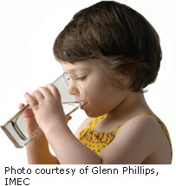
4) Increase drinking water protection fee
Issue: Needed increase to MDH Service Connection Fee
Action: Legislation-change statute
Budget Impact: NA
Justification:
Fees ensure that water infrastructure is adequate/safe
Fee structure has not been increased
Affects safety of public drinking water
Allows condition assessments and asset management plans
Specific recommendations:
Change Statute: Annual fee change from $6.36 to $9.72 for service connections to public water supplies
Discussion and decision
Agencies involved (MDH)
Notes:
What we hope to leave you with is a much better understanding of our state’s groundwater resources and appreciation for the challenges we face.
Simply stated the problem we are increasingly recognizing is that there are ….

Slide 10
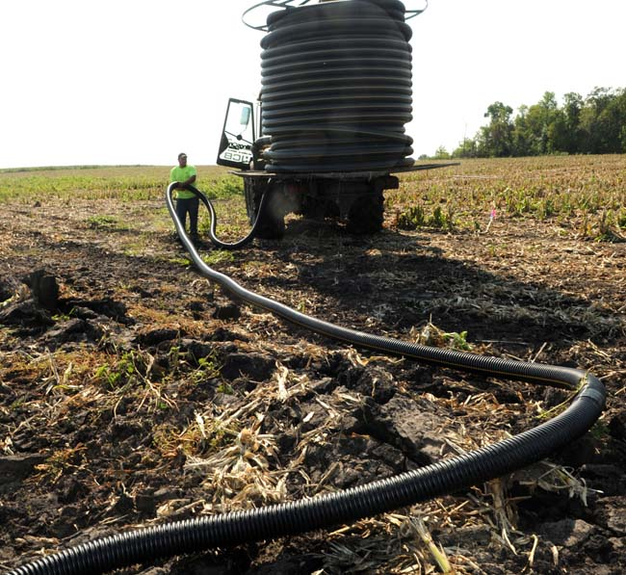
5) Water Retention- Keeping Water on the Land
2019 Legislative Recommendations
Legislative Water Commission
Water Sustainability: Information, Education and Public Awareness
November, 2018
LWC_2019_Recs_November_with_Leg_Bill_Sustainablity_Info_Education_Awareness.docx
2019 Legislative Recommendations
Legislative Water Commission
Water Sustainability: Information, Education and Public Awareness
November, 2018
LWC_2019_Recs_November_with_Leg_Bill_Sustainablity_Info_Education_Awareness.docx
Issue: Water Retention– Keeping water on the Land
Action: Legislative Initiative and Funding Recommendations
Budget Impact: Significant impact (see below)
Justification:
Water retention improves agriculture, water and soil, gw recharge
This is a complex topic that has multiple aspects
Support legislation that simplifies and combines water planning
Evaluate and customize BPM applications at the best places
Specific recommendations: This is a complex topic involving
several agencies. A bill is needed to incorporate the parts
Support agency evaluations of best BMPs, at the best locations
Increase GF obligation for targeted/efficient/incentivized BMPS
Determine extent and impact of tiles/drains
Support return on investment evaluation of BMPs (UM)
Support consensus decisions from the DWG
Increase incorporation of water storage and treatment goals into 1 watershed/1 plan (BWSR)
Evaluate urban BMPS (PCA)
Legislation: Revise and support HF 3908 to create efficiencies in state plans and local plans
Expand pilot pollutant trading options (MPCA)
Recommendation: Create efficient trading credit- exchange vehicle (MPCA)
Agencies involved (BWSR, MDA, MPCA, UM and DNR) (Budget estimate in progress)
Discussion and decision

Slide 11
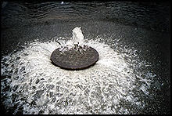
6) Inflow and Infiltration
Issue: Inflow and infiltration create significant infrastructure problems for sanitary districts
Action: Legislation to change a statute
Budget Impact: NA
Justification:
Inflow and infiltration leaks are a major concern and problem
Affects drinking water, groundwater, wastewater
Specific recommendations:
Legislation: To allow sanitary districts the use of existing revenue to mitigate public and private inflow and infiltration problems
This would align statues with those of cities
Discussion and decision
Agencies involved: Metropolitan Council, MPCA

Slide 12
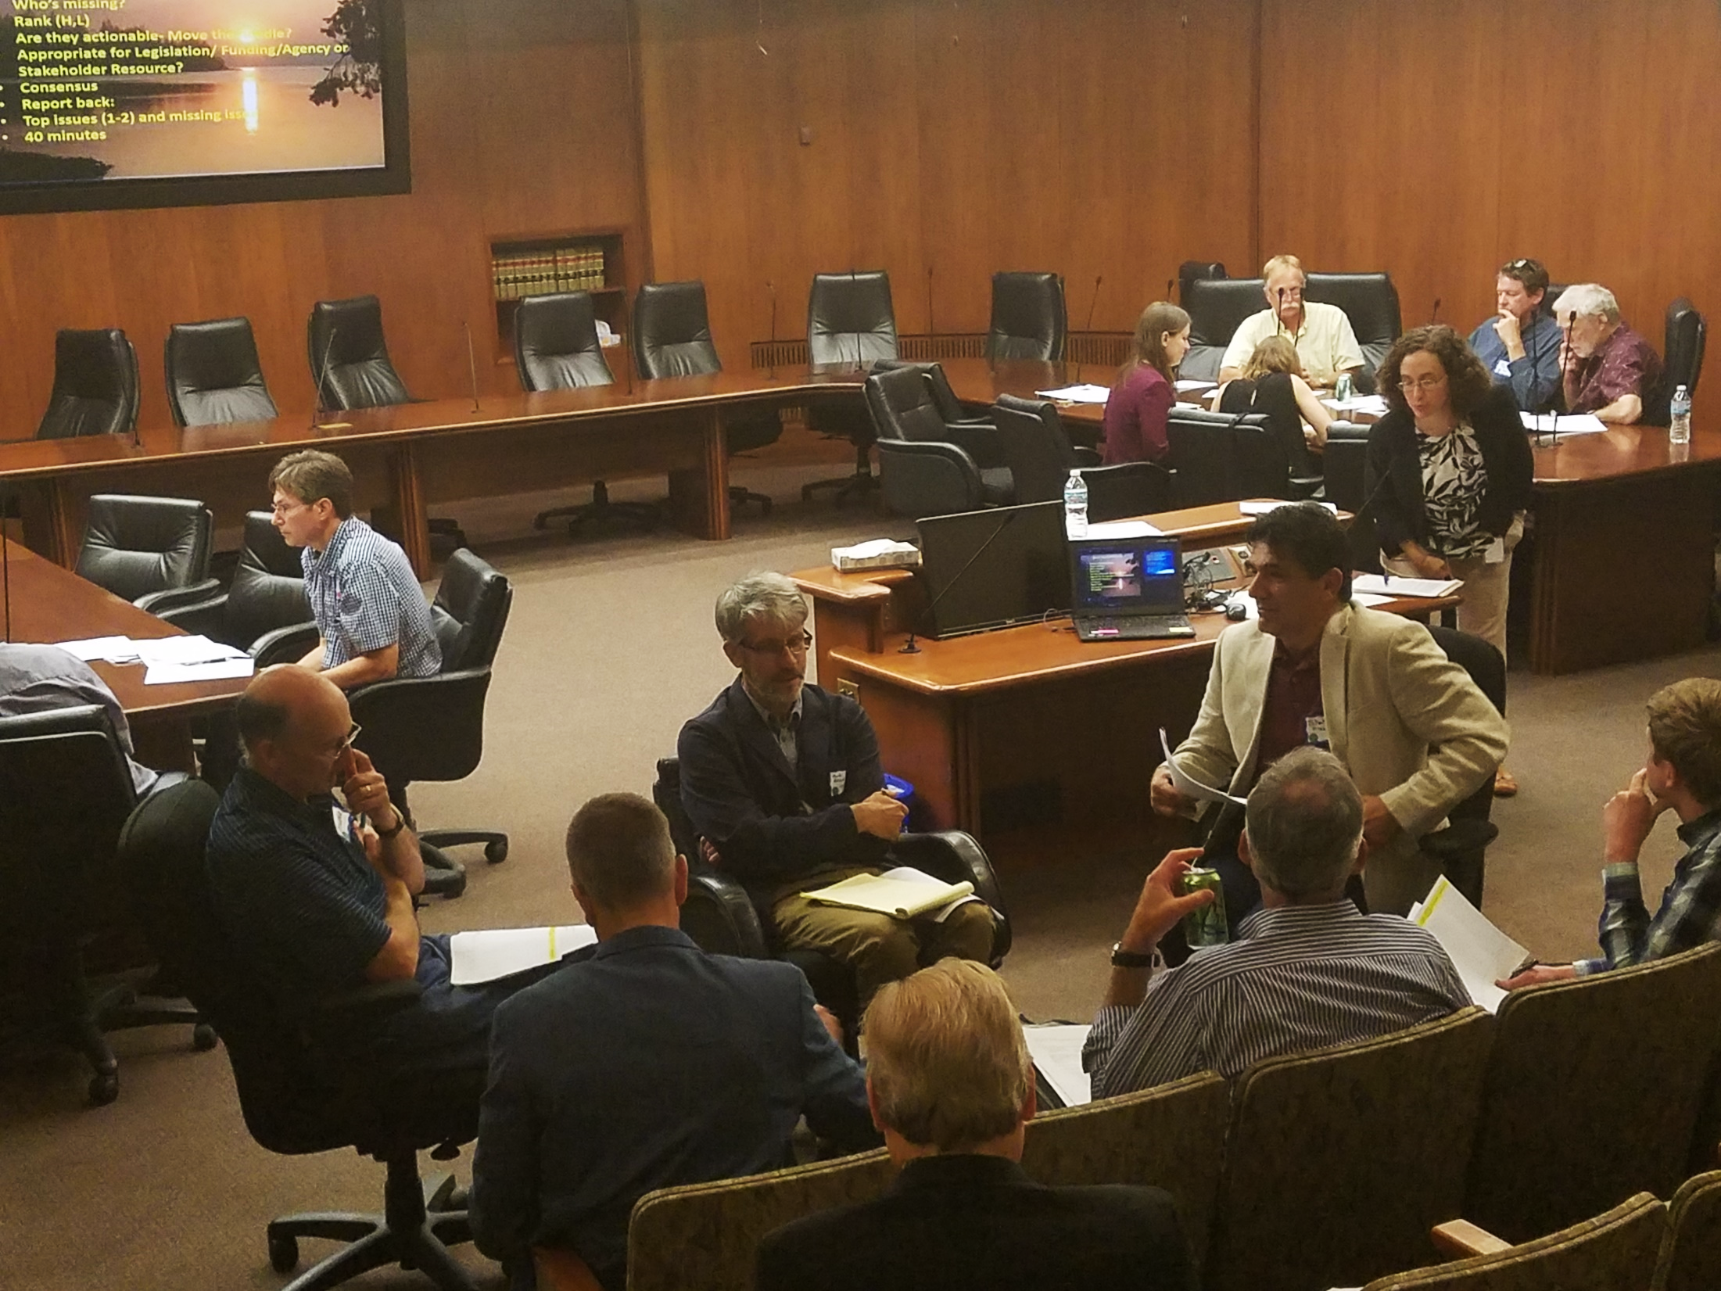
7) Continuation of the Legislative Water Commission
2019 Legislative Recommendations
Legislative Water Commission
Water Sustainability: Information, Education and Public Awareness
November, 2018
LWC_2019_Recs_November_with_Leg_Bill_Sustainablity_Info_Education_Awareness.docx
2019 Legislative Recommendations
Legislative Water Commission
Water Sustainability: Information, Education and Public Awareness
November, 2018
LWC_2019_Recs_November_with_Leg_Bill_Sustainablity_Info_Education_Awareness.docx
Issue: Continuation of the Legislative Water Commission
Action: Bill to Continue the LWC
Budget Impact: unchanged
Justification:
Water issues are wide-ranging and highly varied
Water policy needs to be thoughtfully considered
Commission disseminates information to the Legislature
Provides venue to discuss technical information
Creates a public forum for interactions among legislators and stakeholders
Helps develop water expertise within Legislature
Specific recommendation:
Introduce bill to continue the Legislative Water Commission
Discussion and decision

Slide 13
8) Healthy Soil/Healthy Water
Issue: Healthy Soil- Healthy Water
Action: Legislative Support and Funding Recommendation
Budget Impact: Minor impact (see below)
Justification:
Healthy soil is good for agriculture and for waters of the state
Healthy soil is defined in state
Long-term plan is needed.
Specific recommendations:
Legislative support for Office for Soil Health (UM) (CWF presently)
Permanent general Fund recommendation for the Office
Leg. funding recommendation to develop a soil- action plan
Leg. Recommendation--feedlot master plan (MPCA)
Funding would support work by: BWSR, MDA, UM, MPCA
Budgetary Considerations:
Budget Estimate: $400K per biennium (Office of Soil Health)
Future extension activities: $500-700K, per biennium
Discussion and decision
.

Slide 14
9) K-12 Water Education
2019 Legislative Recommendations
Legislative Water Commission
Water Sustainability: Information, Education and Public Awareness
November, 2018
LWC_2019_Recs_November_with_Leg_Bill_Sustainablity_Info_Education_Awareness.docx
2019 Legislative Recommendations
Legislative Water Commission
Water Sustainability: Information, Education and Public Awareness
November, 2018
LWC_2019_Recs_November_with_Leg_Bill_Sustainablity_Info_Education_Awareness.docx
Issue: Increase Water Education in public schools
Action: Legislative recommendations and funding
Budget Impact: Minor impact
Justification:
Water curriculum needs to be strengthened
Standards include basics
Classroom content is minimal
However, educational resources are available and good
Teachers don’t have resources to apply available curriculum
Standards review is underway and is being strengthened
Specific recommendations: Bill to provide legislative direction:
Address standards and curriculum
Create mechanism to break down silos of expertise
Create a coordination vehicle to link NPOs, teachers, students and volunteers
Provide local subject matter experts for teachers and students
Consider using the DNR volunteer platform
Discussion and decision
Agency involved: MDNR

Slide 15
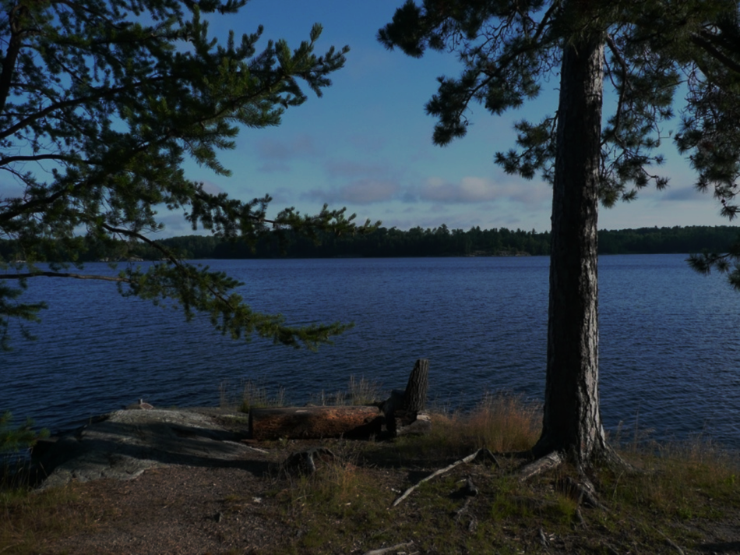
10) Preserving and Protecting Minnesota’s Lakes
2019 Legislative Recommendations
Legislative Water Commission
Water Sustainability: Information, Education and Public Awareness
November, 2018
LWC_2019_Recs_November_with_Leg_Bill_Sustainablity_Info_Education_Awareness.docx
2019 Legislative Recommendations
Legislative Water Commission
Water Sustainability: Information, Education and Public Awareness
November, 2018
LWC_2019_Recs_November_with_Leg_Bill_Sustainablity_Info_Education_Awareness.docx
Issue: We need to prepare to protect/preserve our lakes
Actions: Legislation and Legislative recommendations
Budget Impact: (see below)
Justification:
Lakes are one of the state’s most important assets
However, they are threatened on several fronts
We can’t protect all of our lakes
We need to prioritize and plan to manage lakes
This is a complex topic involving several parts and several agencies. A bill is needed to incorporate the parts and to prepare an implementation plan by the EQB
Fund a short (2-year) recommendation to best preserve lakes, that:
Assesses the economic value of out lakes
Determines the adequacy of our lake information
Provides a method to prioritize lakes for best management
Provides a framework to address stresses and BMPs
Describes a process to best address emerging threats
Outlines a best use of conservation easements to protect threatened lakes
Outlines provide mitigation measures for an uncertain future
Entities involved: (EQB, DNR, MPCA, UM, BWSR, MPCA)
(Interagency effort: $500K/year)
Discussion, decision and direction

Slide 16
11) Peer Review of Wastewater Standards
2019 Legislative Recommendations
Legislative Water Commission
Water Sustainability: Information, Education and Public Awareness
November, 2018
LWC_2019_Recs_November_with_Leg_Bill_Sustainablity_Info_Education_Awareness.docx
2019 Legislative Recommendations
Legislative Water Commission
Water Sustainability: Information, Education and Public Awareness
November, 2018
LWC_2019_Recs_November_with_Leg_Bill_Sustainablity_Info_Education_Awareness.docx
Issue: MPCA Peer Review of Wastewater Standards
Action: Legislation
Budget Impact: NA
Justification:
Numeric wastewater standard process follows EPA protocol
MPCA process provides early peer review
Ensures scientific and public review of numeric changes
This process is based on a Commissioner’s order
Process needs to be set into statute for future consistency
Specific recommendations:
Legislation: incorporate Commissioner’s order into statute.
Discussion and decision
Agency involved : MPCA

Slide 17
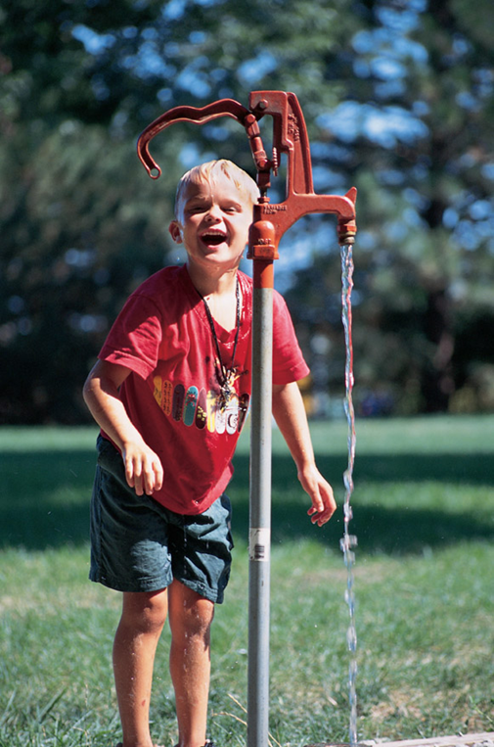
12) Water Infrastructure (waste, storm and drinking water)
2019 Legislative Recommendations
Legislative Water Commission
Water Sustainability: Information, Education and Public Awareness
November, 2018
LWC_2019_Recs_November_with_Leg_Bill_Sustainablity_Info_Education_Awareness.docx
2019 Legislative Recommendations
Legislative Water Commission
Water Sustainability: Information, Education and Public Awareness
November, 2018
LWC_2019_Recs_November_with_Leg_Bill_Sustainablity_Info_Education_Awareness.docx
Issue: Continued support to ensure that infrastructure is adequate
Infrastructure is aging and presents threats to public health and economy
Legislative Actions: Legislation and funding
Budget Impact: Significant impact
Justification:
Water-related infrastructure is aging and threatens public health and our economy. Continued support is needed
Encourage efficiencies, cooperation and innovation
This is a complex topic involving several agencies. A bill is needed to recommend actions and to seek funding for specific topics:
Support PFA’s GO bonding requests on a continuing basis
Funding recommendation: Enhance MPCA’s cost-effectiveness reviews for treatment-alternatives ($?)
Funding request: Increase funding for WW efficiencies and alternatives (MPCA) ($?)
Funding: Increased funds for MPCA and MDH-- to encourage facilities innovation
Funding: Increase funds or community asset management (PCA , PFA) ($?)
Legislation: Implement market based water-quality trading process (MPCA )
Funding: Support MDH initiatives that address risks to public health, such as lead service-line replacements
Recommend and support programs to identify and remediate the areas of failing septic
systems (MPCA) ($?)
Discussion and decision
Agencies involved : PFA, MPCA, MDH

Slide 18
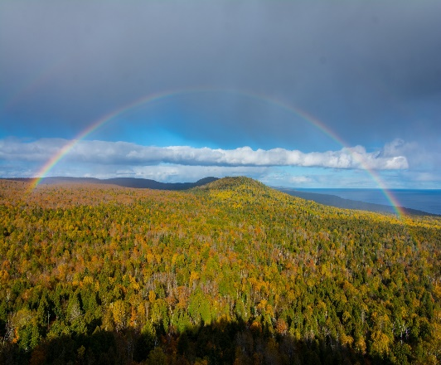
13) Statewide Water Policy: Planning for an Uncertain Future
2019 Legislative Recommendations
Legislative Water Commission
Water Sustainability: Information, Education and Public Awareness
November, 2018
LWC_2019_Recs_November_with_Leg_Bill_Sustainablity_Info_Education_Awareness.docx
2019 Legislative Recommendations
Legislative Water Commission
Water Sustainability: Information, Education and Public Awareness
November, 2018
LWC_2019_Recs_November_with_Leg_Bill_Sustainablity_Info_Education_Awareness.docx
Issue: Statewide Water Policy: Planning for uncertain future conditions
Action: Legislative recommendation and funding support
Budget impact: Minimal
Justification:
As a state, we need to begin to prepare for an uncertrain future
Floods, drought, and storm damage near Duluth are recent examples
This will require a long-term focus and plan
Changes likely will be driven by land use, agriculture, hydrology and weather
A plan for policy is needed guide policy to adapt to changes that are likely
Legislative direction for a planning process and report to the legislature is a first step
Stakeholder support is strong
This is a complex topic involving several agencies. A recommendation is needed to request that EQB incorporate this into biennial report to the legislature. Some supplemental funding may be needed.
Prepare a statewide water policy plan that recognizes an uncertain future (EQB)
Establish an interagency/legislative water-policy team
Prepare a draft water policy plan for the Legislature
Partners: EQB, environmental agencies, Stakeholders, LWC
Anticipated budget requirement (Agency Support) ($?)
Discussion and decision
Agencies Involved: EQB and others

Slide 19
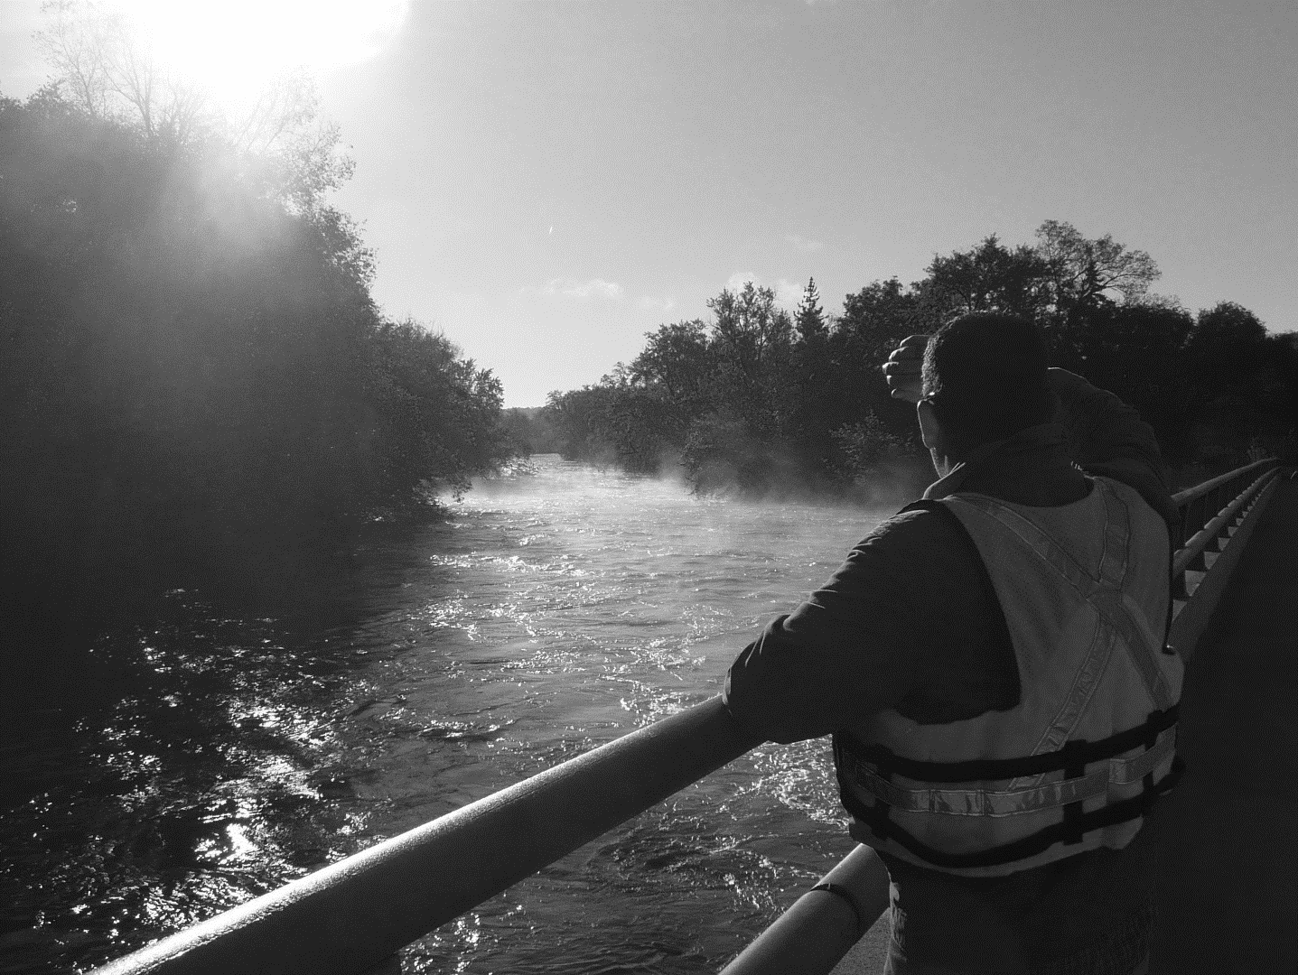
Final Thoughts:
Session Meeting Schedule?
Next Steps
Press release?
Glossy information publication
Briefings to committees?
Stakeholder meetings?
Other work?
General Fund/Legacy Fund comparison
19

Slide 20
Happy Holidays
Notes:
For more information and real time monitoring data you can visit this web site.

